Slide 1
Computer Vision
Leonardo Merza
University of South Carolina

Slide 2
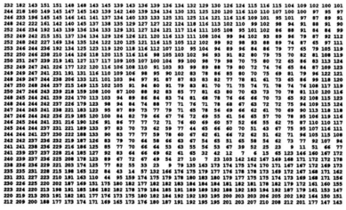
History
1960 – Larry Roberts at MIT
1970’s – Interpreting Images
1980’s – Geometry and Shapes
1990’s – Facial Recognition
1999 – OpenCV From Intel
2008 – Willow Garage
2012 - Raspberry Pi

Slide 3
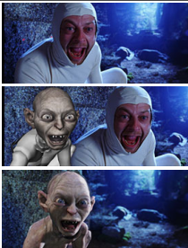
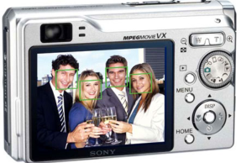
Current Uses
Face Detection in Cameras
Smile Detection in Cameras
3D Modeling
Movie Special Effects
Sports
Video Games (Kinect, PlayStation Eye)

Slide 4
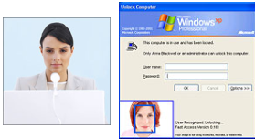
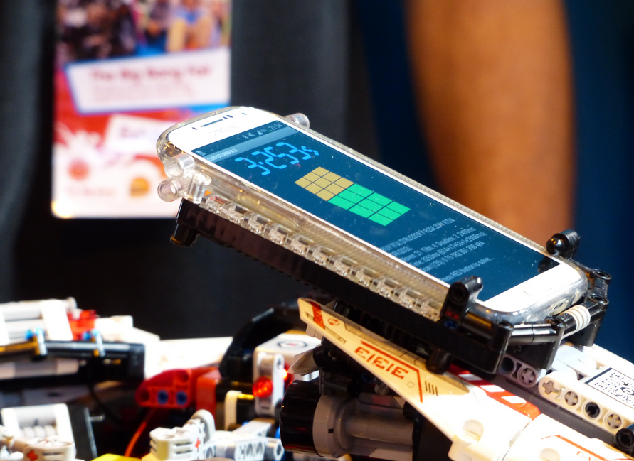
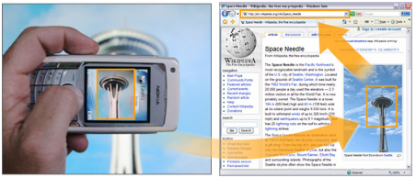
Current Uses
Space Robotics
Converting Text into Files
Biometrics
Augmented Reality
Object Recognition
Rubik’s Cube

Slide 5
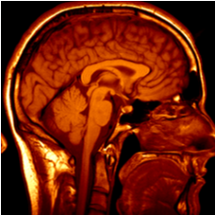
Current Uses at USC
fMRI – Dr. Shinkareva
Engineering Psychology – Dr. Beer
Computer Vision Lab
Image Segmentation
Shape Analysis

Slide 6
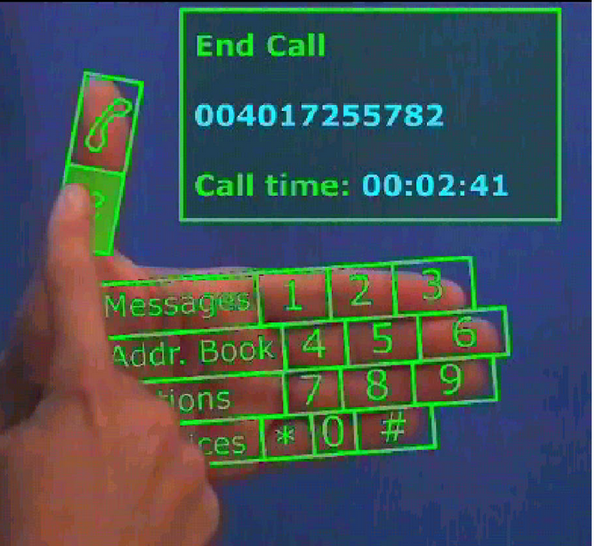
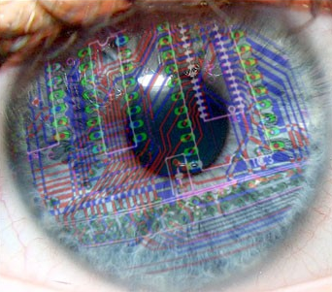
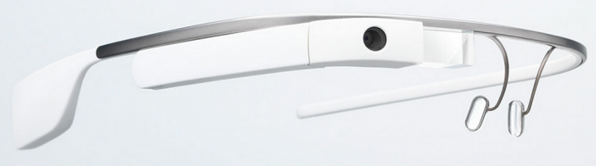
Future
Google Glasses
Contacts
Google Project Tango

Slide 7
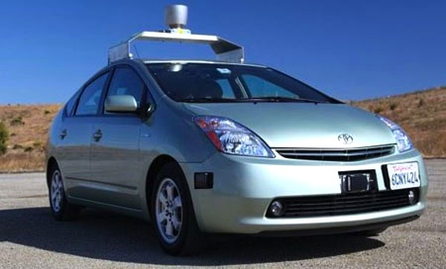
Future – Self Driving Cars
2015 – Audi and Nissan to market self driving vehicles
2017 – Mandated car communication in all new vehicles
2020’s
All major car manufactures sell self driving cars
Majority of cars in big cities are self driven
2030’s
less than 50% of Americans own a car
parking lots, grocery stores redesgined
Humans banned from driving cars
Intersection lights and stop signs fazed out

Slide 8
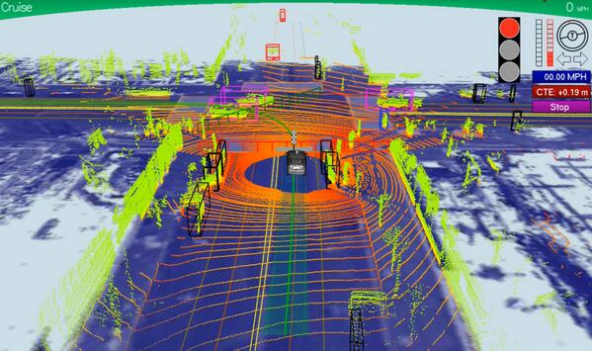
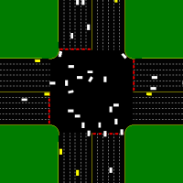
Future – Self Driving Cars

Slide 9
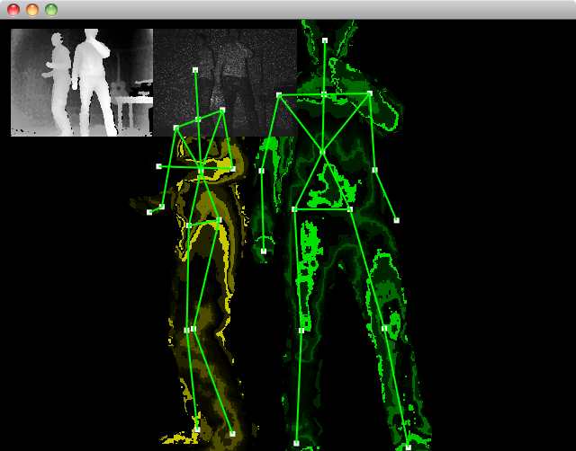
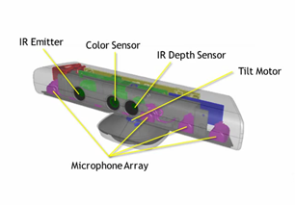
Microsoft Xbox 360 Kinect
0.8 to 4 meters range with mm accuracy
640 x 480 RGB camera @ 30 fps
14 joint body tracking up to 4 people

Slide 10
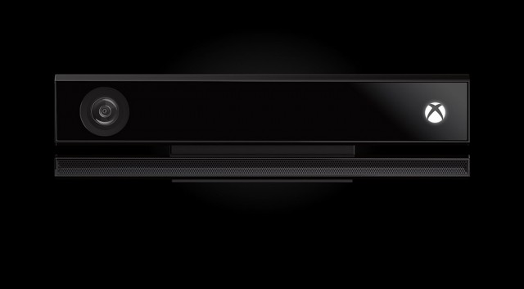
Microsoft Xbox Kinect 2
1080 RGB Camera
25 joint body tracking up to 6 people
Facial Expression Recognition - Gender
Facial Scanning into Games

